Slide 1
Architectural Extensions
Making use of specialized components

Slide 2
Contents
The extension layers take care of various aspects:
Middleware – communication and deployment.
Shared Repository – persistence and synchronization.
Proxy – protocols, routing, and security.
Orchestrator – integration and use cases.
Combined Component – multiple aspects.

Slide 3
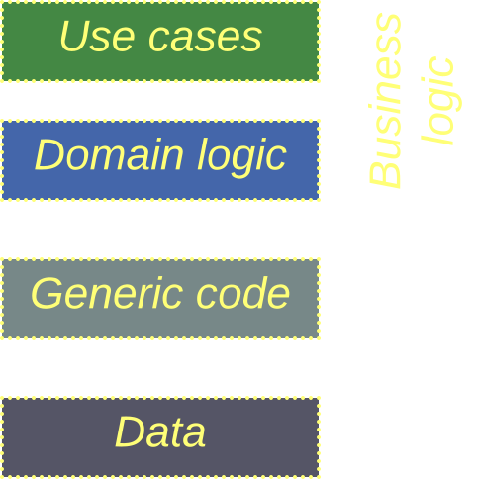
Schema
In most cases we’ll be adding layers to a system of subdomain Services.
However, the same techniques tend to work with Shards or even Layers.
The components are color-coded

Slide 4
Middleware
A communication layer

Slide 5
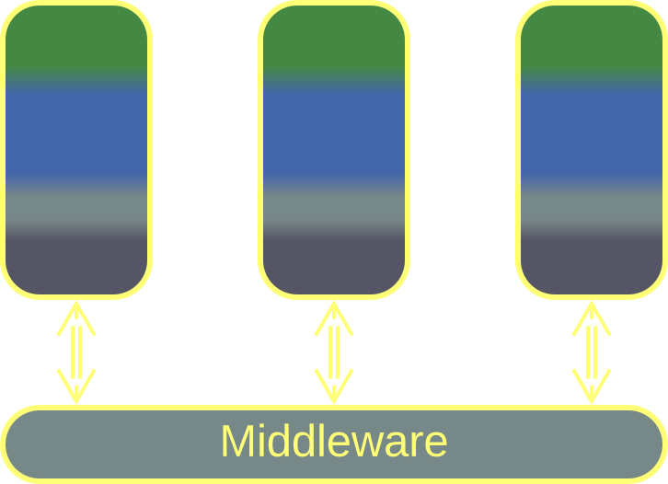
Middleware – overview
A Middleware is a system-wide layer which provides other system components with means of communication.
A Middleware may function as:
A Message Broker – it lets its users message or call each other in a uniform manner.
A Deployment Manager – it supervises scaling and error recovery of the services it hosts.
Middleware
Middleware helps communication and scaling in complex systems.
But it may be overly generic for high-load or low latency cases.

Slide 6
Middleware – trade-offs
Encapsulates connectivity concerns
Takes care of scaling of components
Is available off the shelf
May increase latency
May not support specialized transports
May become a single point of failure

Slide 7
Middleware – addressing
A Middleware works in one of the following addressing modes:
Channels (one to one) – two components establish a communication channel. Anything pushed to one end of the channel pops out of its other end.
Actors (many to one) – every component has a public mailbox. Any component that knows its name or address can post there a message.
Publish / subscribe (one to many) – a component published updates to a topic. Other components that subscribe to the topic are notified of the updates.
Gossip (many to many) – every replica of a component periodically synchronizes its state with other random replica.

Slide 8
Middleware – flow
A Middleware can be used in the following ways:
Notifications – a component sends a message that indicates that an event has happened and continues its tasks. It is up to other components to subscribe to the message and continue the use case (choreography).
Request / confirm – a component sends a request to another component (orchestration) and proceeds to its other tasks (Proactor). As soon as it receives the confirmation for its original request, it returns to its original task.
Remote procedure call (RPC) – a component sends a request (orchestration) and blocks (Reactor) on the Middleware till it receives the corresponding confirmation. Then in continues its task.

Slide 9
Middleware – delivery guarantee
As networks and components tend to fail, messages may be lost or duplicated:
Exactly once – the slowest mode of communication, often implemented with distributed transactions. Fits financial applications.
At least once – messages are re-delivered on failure, risking a duplication. Therefore message processing should be idempotent.
At most once – a message is lost on any failure. This is acceptable when the data that comes in messages is aggregated, as with weather sensors.
At will (no guarantee) – raw UDP traffic that allows for message loss, duplication, and reordering. It is fast, simple, and stupid, but now the application itself must ensure message order and validity.

Slide 10
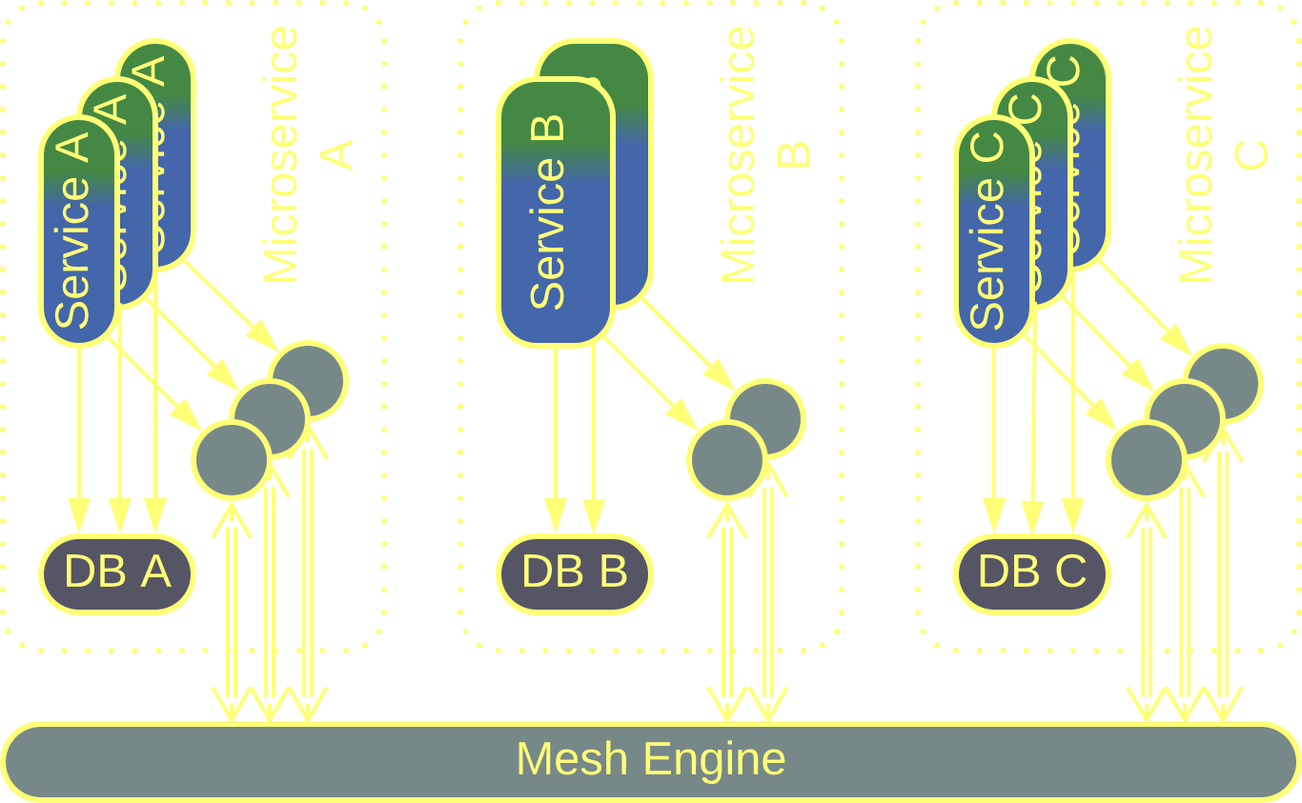
Middleware – composites
Service Mesh is a Mesh-based Middleware with a Proxy per instance of client service.
The Proxies contain shared libraries and interface to the Mesh and are co-located (Sidecar) with the clients.
Service Mesh is elastic – it spawns new instances of services under heavy load and deletes them when idle.
Service Mesh
Service Mesh brings in elasticity and shared libraries.
Its implementation is complex, and you will be locked to its vendor.

Slide 11
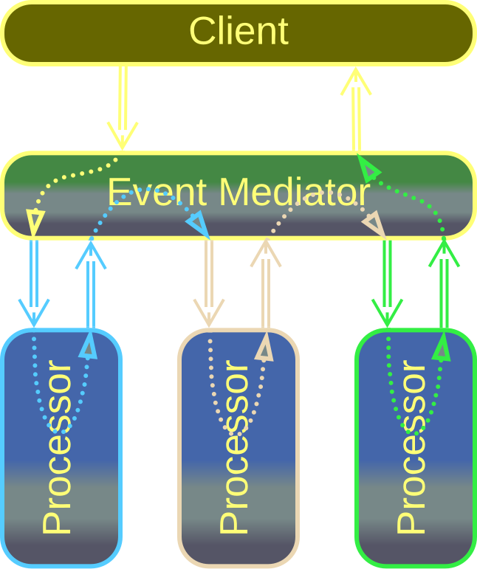
Middleware – composites
Event Mediator is Middleware + Orchestrator.
As an Orchestrator, it decides which message goes to which service, thereby implementing use cases.
As a Middleware, it provides communication, scaling, and fault recovery.
Event Mediator
Event Mediator is a framework for Event-Driven Architecture.
It may grow too complex if there are many use cases.

Slide 12
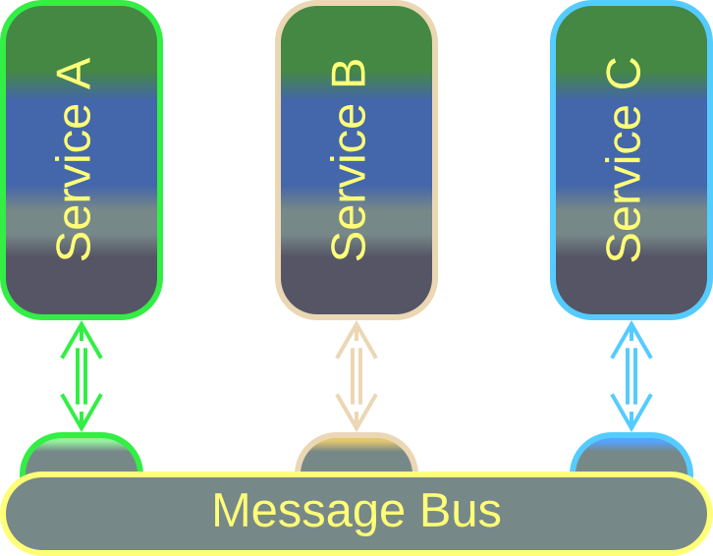
Middleware – composites
Message Bus is a Middleware with an Adapter per client component.
The Adapters translate between the components’ protocols and the protocol used inside the Message Bus.
That enables the integration of legacy subsystems without making them communicate in a uniform manner.
Message Bus
Message Bus allows for integrating legacy services.
However, protocol translation slows down the communication.

Slide 13
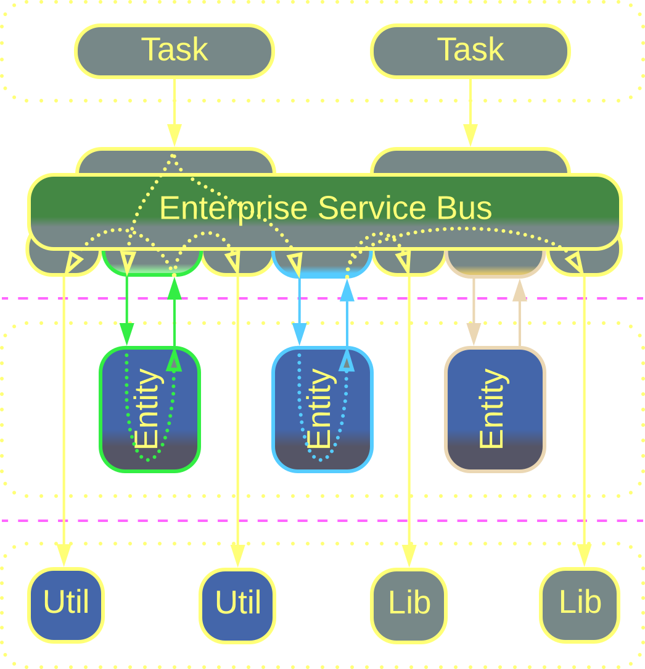
Middleware – composites
Enterprise Service Bus (ESB) is Event Mediator + Message Bus.
It orchestrates the system by knowing the destination for every kind of message, just like an Event Mediator.
It translates between protocols like a Message Bus.
Enterprise Service Bus
ESBs integrate legacy subsystems in enterprise networks.
They tend to become very complicated, undermining development.

Slide 14
Shared Repository
A data layer

Slide 15
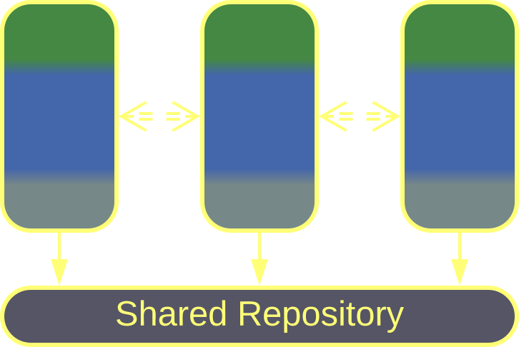
Shared Repository – overview
A Shared Repository is a data layer shared by other system components. Its functions include:
Persistence – storing the data.
Consistency – providing atomic transactions.
Notifications – letting a component know when data changes.
Shared Repository
Shared Repository enables data-centric or simple projects.
It may not be flexible enough for high-load or evolving domains.

Slide 16
Shared Repository – trade-offs
Supports coupled data
Grants data consistency
Helps saving on hardware and administration
Allows for a quick start of a project
Couples its clients to a shared schema
Has a limited scalability
May not fit the needs of its clients equally well
May be a single point of failure

Slide 17
Shared Repository – variants
Pattern | Usage example
Shared memory | Instant communication in HFT
Shared file system | ETL pipelines
Shared database, integration database | Data-centric domains (seat reservation), quick start of service-based projects

Slide 18
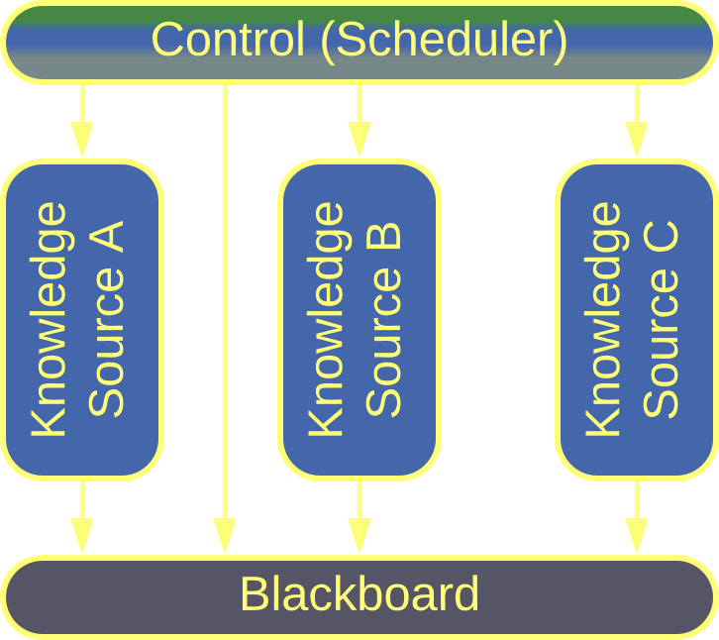
Shared Repository – examples
Blackboard was used for non-deterministic calculations.
An individual algorithm (knowledge source) reads whatever inputs it needs from the blackboard and adds its output to the blackboard.
The scheduler (control) chooses the best algorithm to run next based on the data currently available on the blackboard.
Blackboard

Slide 19
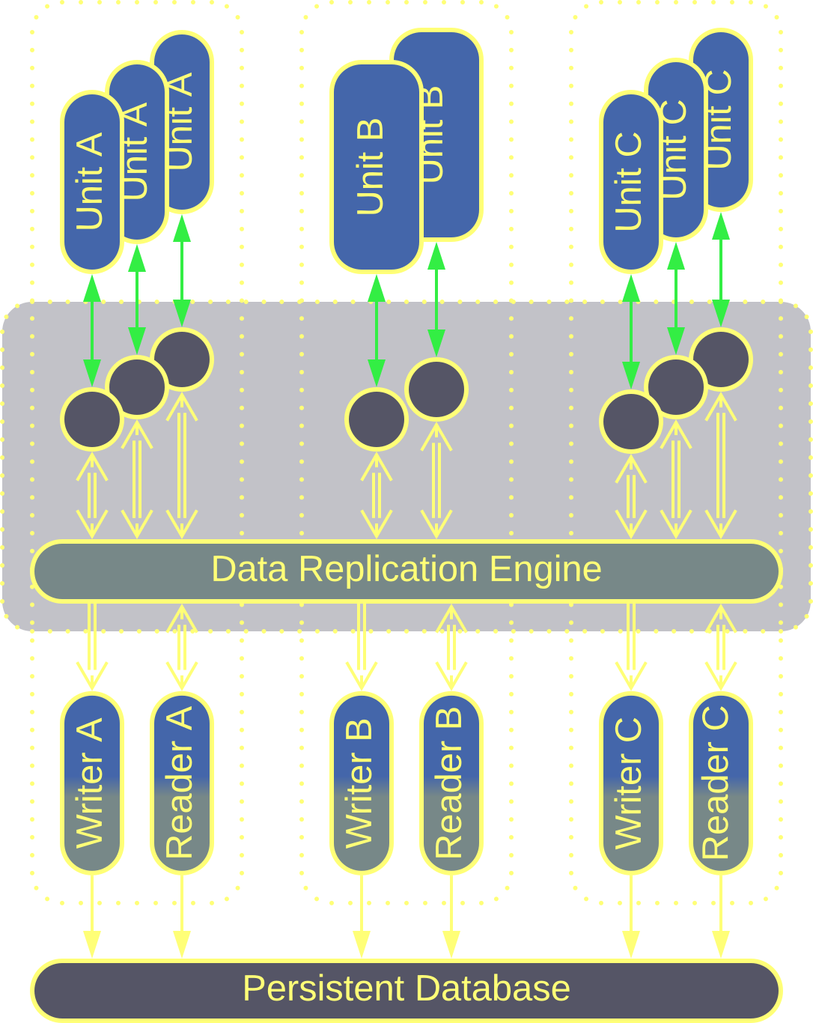
Shared Repository – examples
Data Grid is a virtual shared dictionary that runs in a Mesh. It is the foundation of Space-Based Architecture.
Every instance of every service in the system has a replica of the entire system’s dataset. When a service ()writes to its replica, the Data Replication Engine copies the changes to every other system component.
The changes are also persisted to a database.
Data Grid
Data Grid is extremely scalable and elastic...
…but frequent writes may result in conflicts.

Slide 20
Proxy
Indirection between a system and its clients

Slide 21
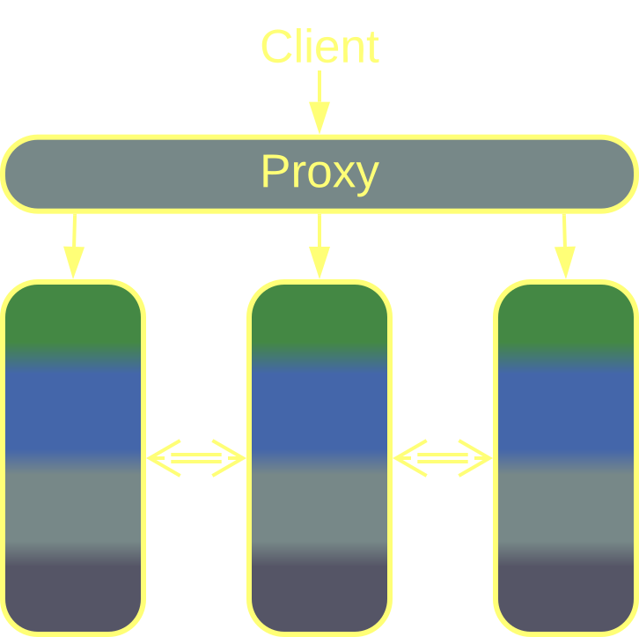
Proxy – overview
A Proxy stands between a system and its clients. Its aspects include:
Routing – connecting a client to a component best suited to serve its needs.
Offloading – implementing shared generic aspects such as protocols, logging, authentication, etc.
Proxy
Proxies help with system security, scaling and protocol support…
…at the cost of slightly increased latency.

Slide 22
Proxy – trade-offs
Implements cross-cutting concerns
Decouples the system from its clients
Acts as a secure perimeter
Is available off the shelf
Most kinds of Proxies degrade latency
May be a single point of failure

Slide 23
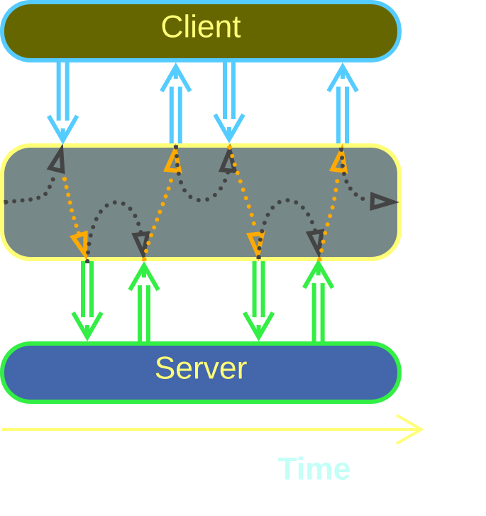
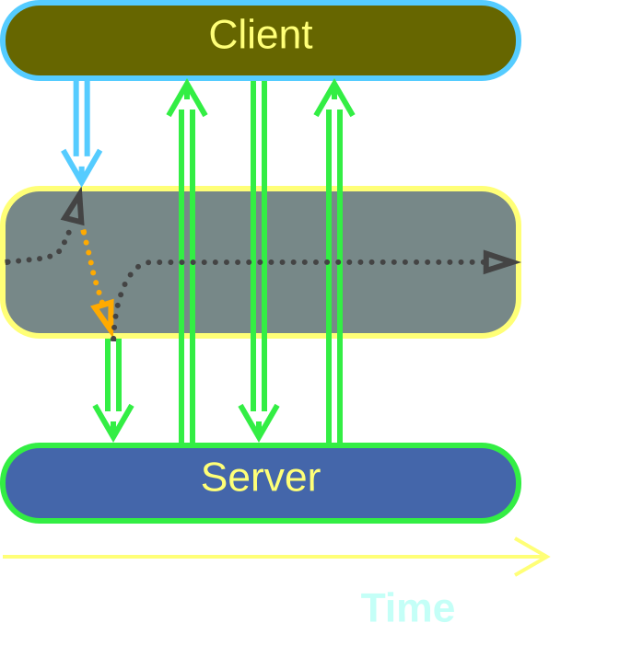
Proxy – transparency
Proxies vary in their level of isolation:
A Full Proxy intercepts every request between the client and the system.
A Half-Proxy helps the client to establish a direct connection to a system component.
Full Proxy
Half-Proxy
Full Proxies provide more security and control…
…at the cost of performance.
Notes:
https://metapatterns.io/basic-metapatterns/layers/

Slide 24
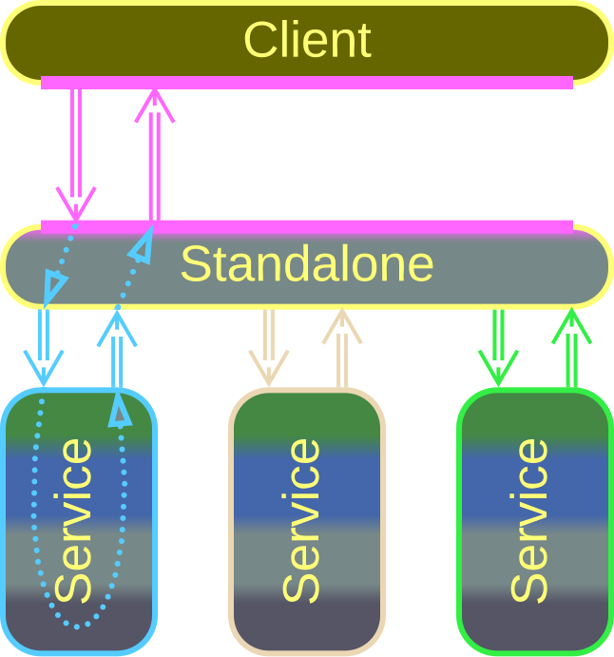
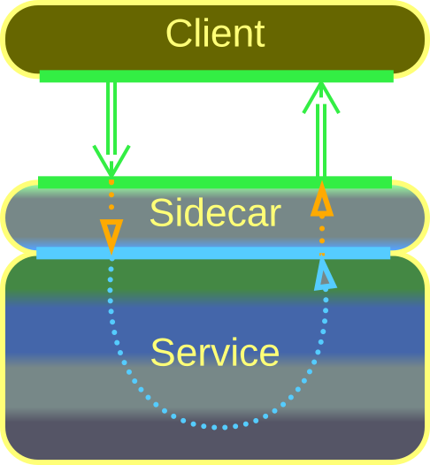
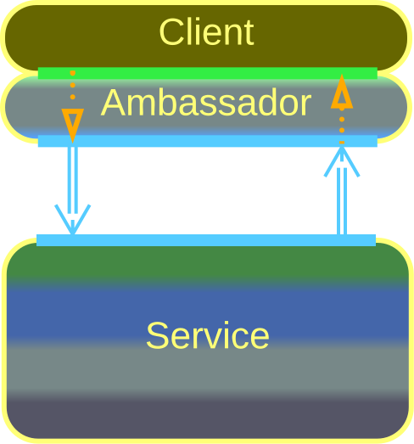
Proxy – placement
Standalone | Sidecar | Ambassador
Separate deployment | Deployed on the system side | Deployed on the client side

Slide 25
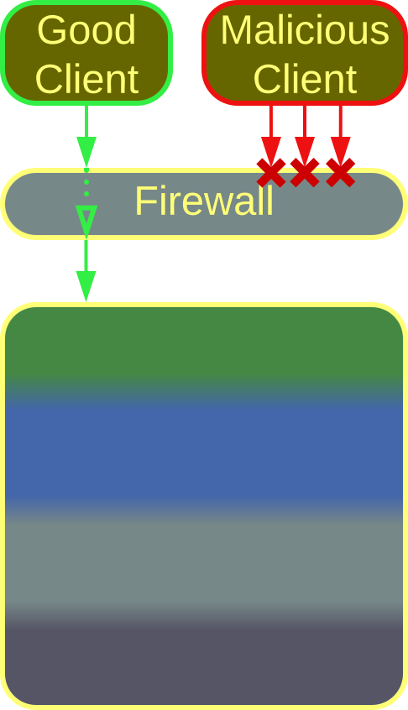
Proxy – variants
A Firewall protects the system from being overloaded by client’s requests.
It should also intercept any attempts to establish a malicious connection.
A Rate Limiter enforces a limit on the frequency of every client’s requests.
Firewall,
Rate Limiter

Slide 26
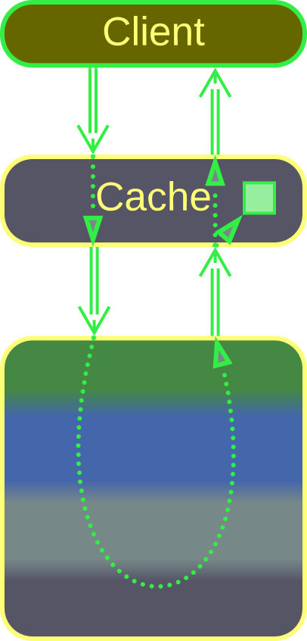
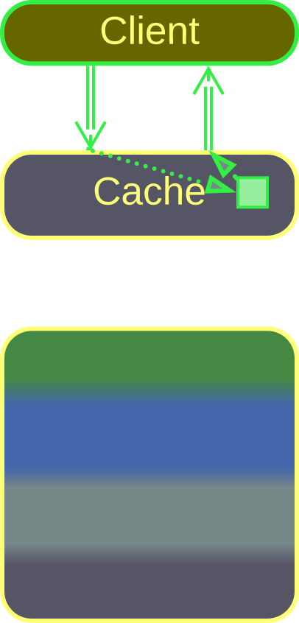
Proxy – variants
A Response Cache remembers what the system answers to clients’ requests.
If it sees a request identical to any one it has seen before, it returns the answer from its memory without consulting the underlying system.
Response Cache – not matched
Response Cache – matched

Slide 27
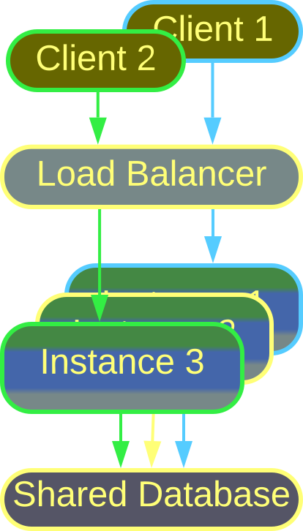
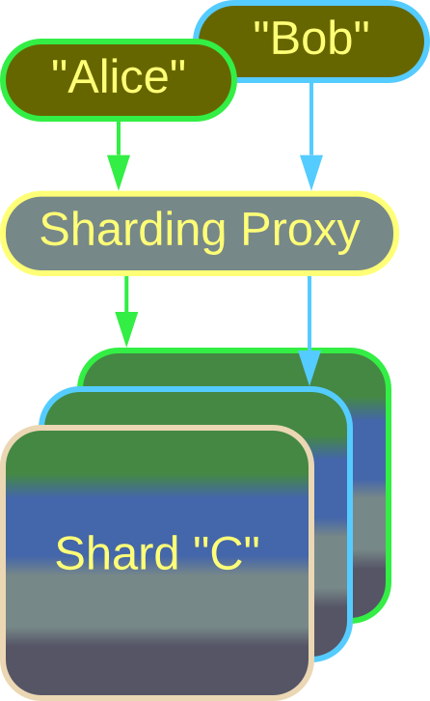
Proxy – variants
A Load Balancer uniformly distributes client requests among the underlying instances of a service to make sure that no instance is overloaded.
A Sharding Proxy connects each client to a shard that contains the client’s data.
Load Balancer
Sharding Proxy

Slide 28
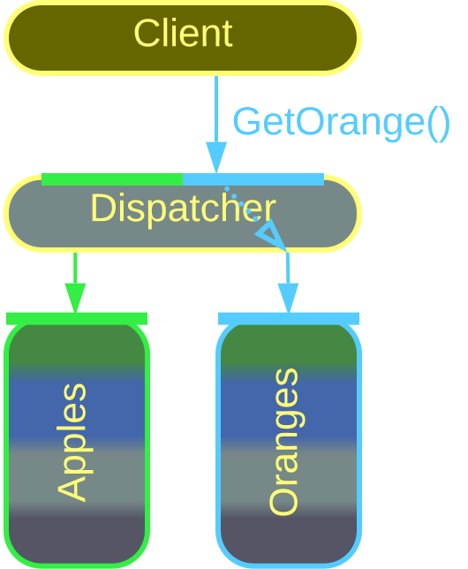
Proxy – variants
A Reverse Proxy forwards a client’s request to the service which knows how to handle it.
Reverse Proxy, Dispatcher

Slide 29
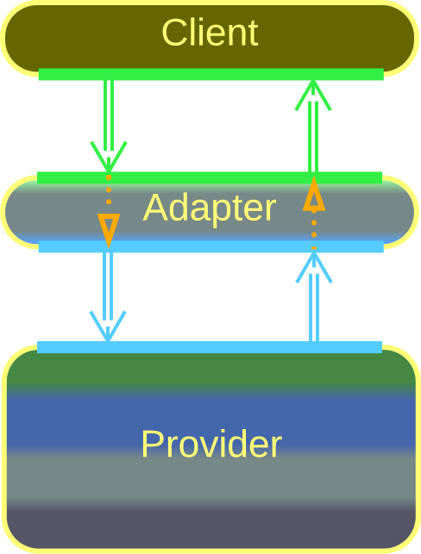
Proxy – variants
An Adapter translates between interfaces on the client’s and on the system’s sides.
An Abstraction Layer is an Adapter used to protect the client from changes in the interface or contract of the underlying system:
It is called Anticorruption Layer when implemented by the client.
It is called Open Host Service when implemented by the system’s team.
Adapter,
Abstraction Layer,
Anticorruption Layer, Open Host Service

Slide 30
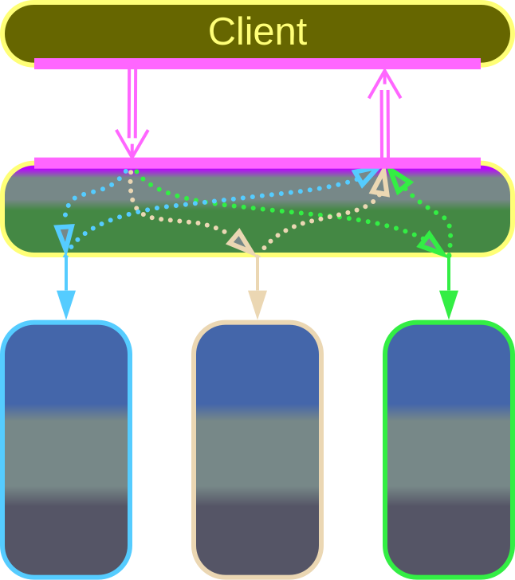
Proxy – composites
API Gateway is an orchestrating Proxy:
It deals with protocol translation as an Adapter (Proxy).
It splits a single client request into multiple requests to the underlying services as an API Composer (Orchestrator).
API Gateway

Slide 31
Orchestrator
An integration layer

Slide 32
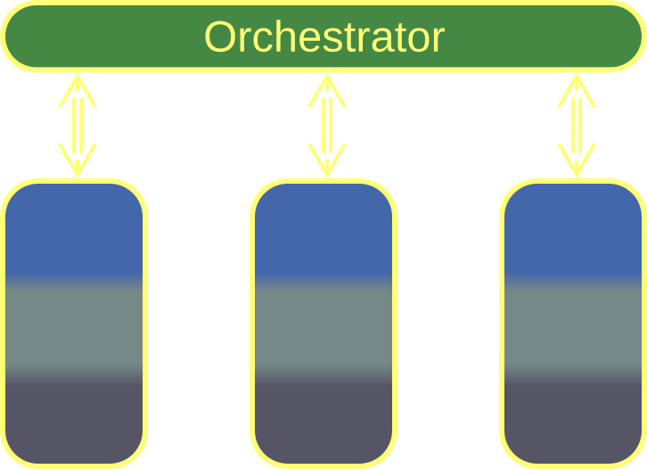
Orchestrator – overview
An Orchestrator integrates lower-level components. It acts as:
A Mediator by propagating state changes among system components.
A Facade by implementing system-wide use cases.
Orchestrator, Application Layer
Orchestrator helps projects with many complex use cases…
…at the cost of increased latency and operational complexity.

Slide 33
Orchestrator – trade-offs
Encapsulates integration concerns
Simplifies making changes to use cases
Protects the teams behind lower-level components from the system’s clients
May degrade the latency and fault tolerance of the system
May grow too large for comfortable development

Slide 34
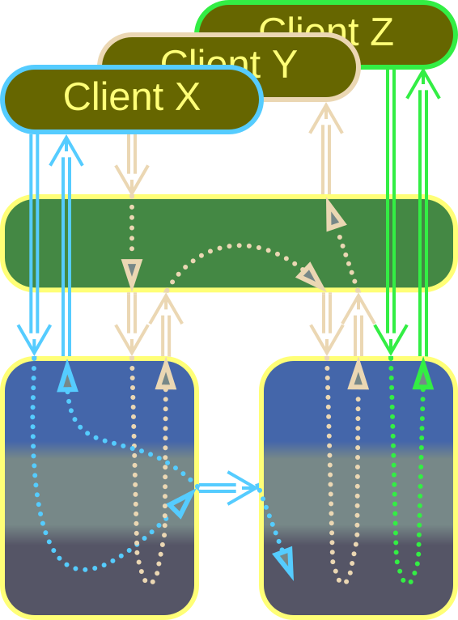
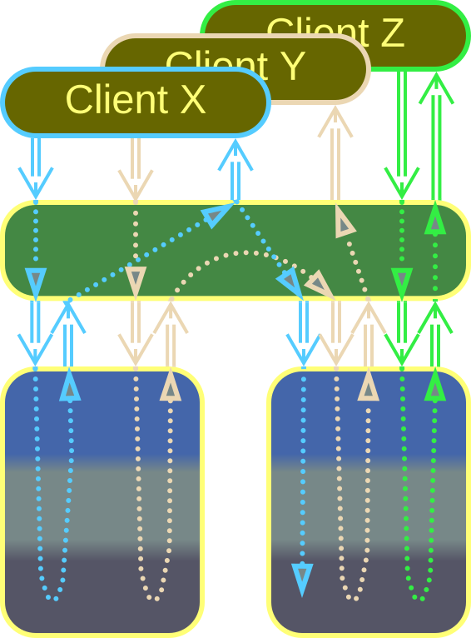
Orchestrator – transparency
Being a layer, an Orchestrator can allow or block its clients’ access to the underlying components:
An Open Orchestrator implements complex use cases but passes simple client requests to the services below it.
A Closed Orchestrator intercepts all client requests, even those that don’t involve multiple services.
Open Orchestrator
Closed Orchestrator
Notes:
https://metapatterns.io/basic-metapatterns/layers/

Slide 35
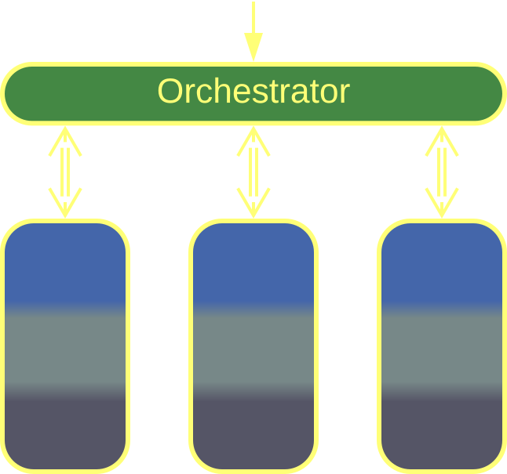
Orchestrator – internals
In the simplest case an Orchestrator is monolithic (or layered if it persists its state to a database for fault recovery).
The single-component structure is good for smaller projects with no stringent requirements.
Monolithic Orchestrator
The monolithic structure is simple and its state is self-consistent…
…but it has limited performance and may become too large.

Slide 36
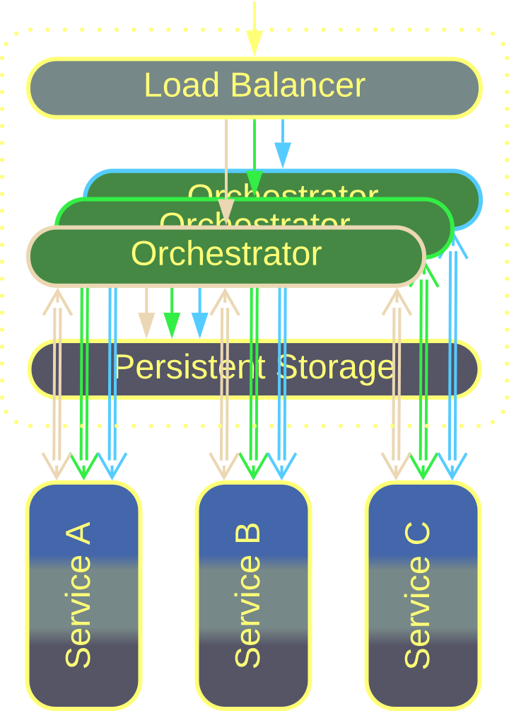
Orchestrator – internals
High availability or high load require multiple instances of an Orchestrator.
The instances rely on a Shared Repository or replication to synchronize their states.
Scaled Orchestrator
Setting up multiple instances increases throughput and availability.
However, the instances must take care to avoid race conditions.

Slide 37
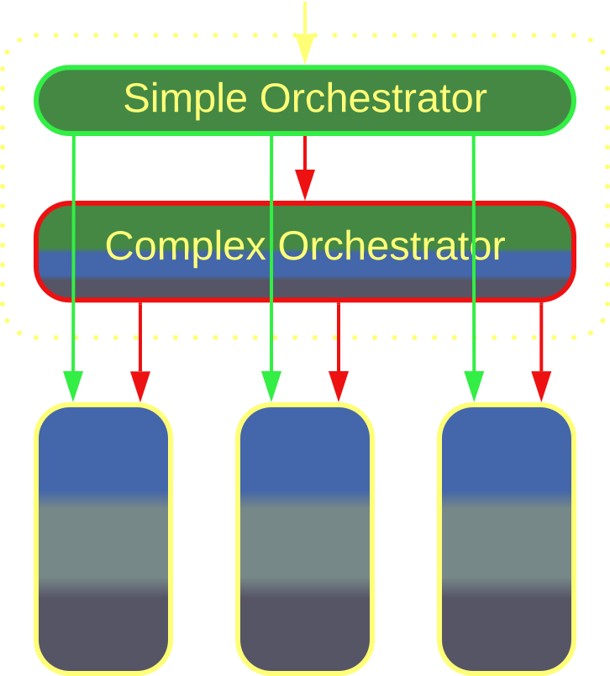
Orchestrator – internals
It is possible to use several Orchestrators of different complexity.
All user requests get to a simple Orchestrator. If it cannot handle a request, it forwards the latter to a more complex implementation.
Layered Orchestrator
A Layered Orchestrator reserves complex code for hard use cases.
But it requires the team to learn multiple technologies.

Slide 38
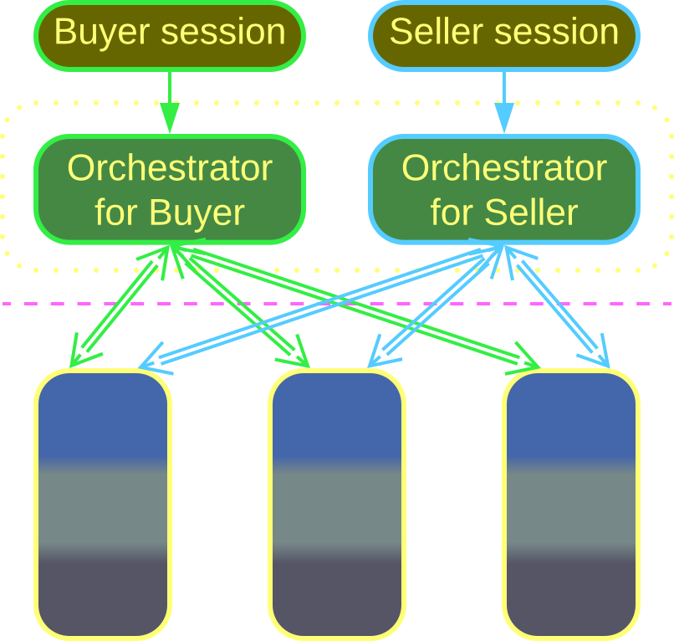
Orchestrator – internals
The orchestration layer may dedicate one service to each kind of client, becoming Backends for Frontends (BFF).
For example, an online store may implement buyer and seller logic with separate Orchestrators.
Backends for Frontends
BFF is good when clients differ in their use cases.
On the downside, it is hard to share code between use cases.

Slide 39
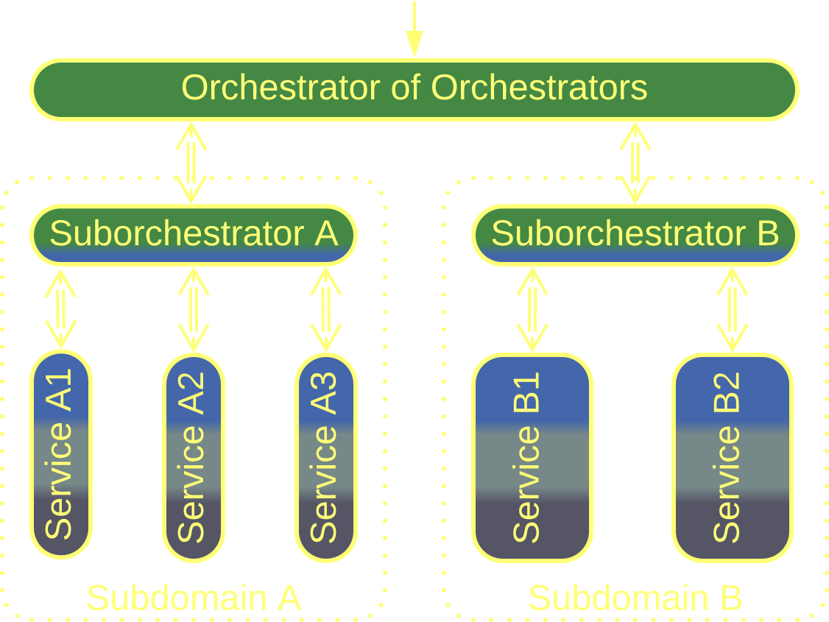
Orchestrator – internals
Top-Down Hierarchy has multiple layers of Orchestrators.
The top-level component operates coarse-grained actions.
Each layer translates a call to its API into several calls to the APIs of the layer below it.
Top-Down Hierarchy
Hierarchy distributes complexity among several layers.
However, only few domains are hierarchical.

Slide 40
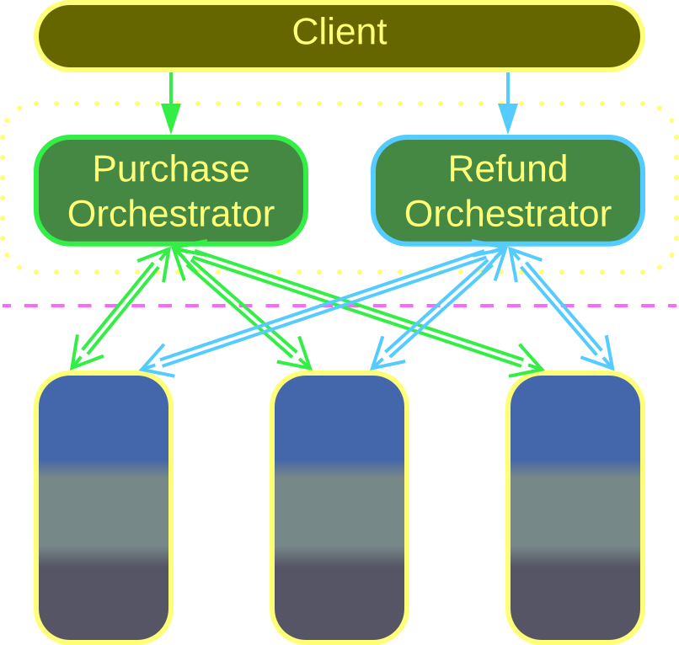
Orchestrator – internals
The SOA-style orchestration relies on many small Orchestrators, each implementing a few closely related scenarios.
SOA-style orchestration
Each Orchestrator stays small and humble.
But there are too many of them.

Slide 41
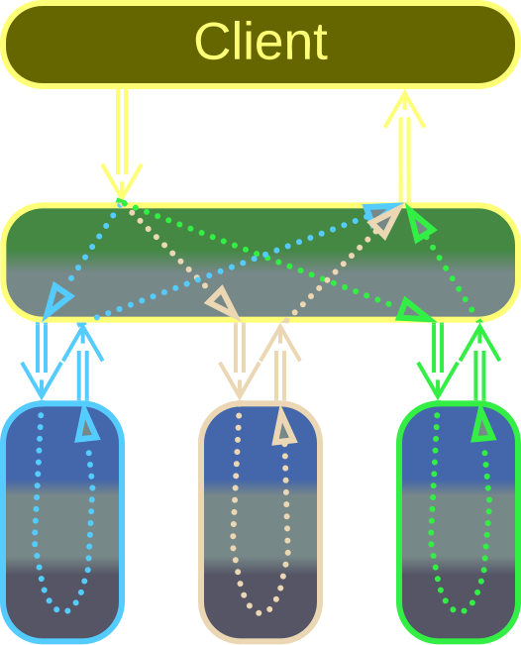
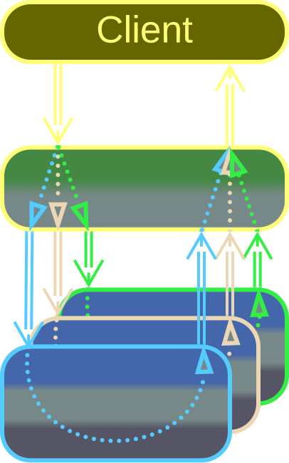
Orchestrator – variants
An API Composer parses a client’s request, forwards its parts to the underlying services, and merges the results into a single response to its client.
With Scatter/Gather or MapReduce a copy of the incoming request is forwarded to each shard, and the results are aggregated and sent to the client as a single response.
API Composer
Scatter/Gather, MapReduce

Slide 42
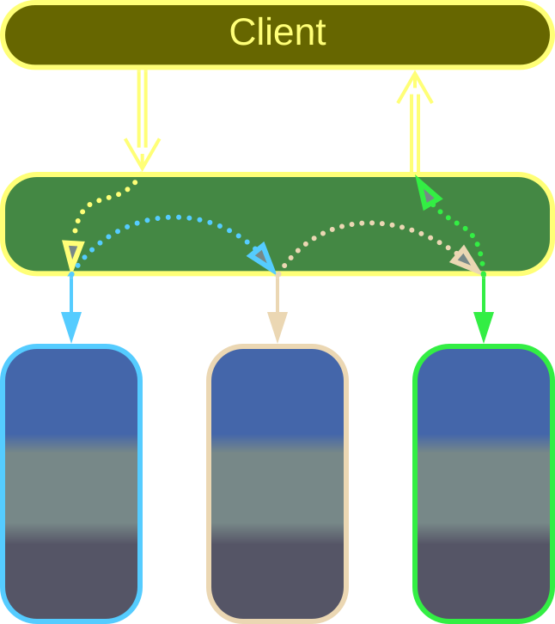
Orchestrator – variants
Unlike API Composer, which runs actions in parallel, Process Manager executes a use case as a sequence of steps.
It can have complex logic with branching and error handling.
Process Manager

Slide 43
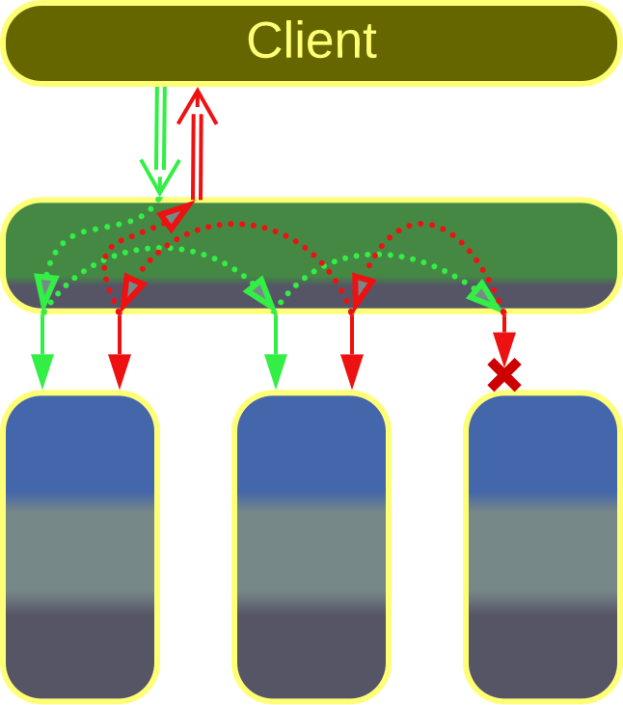
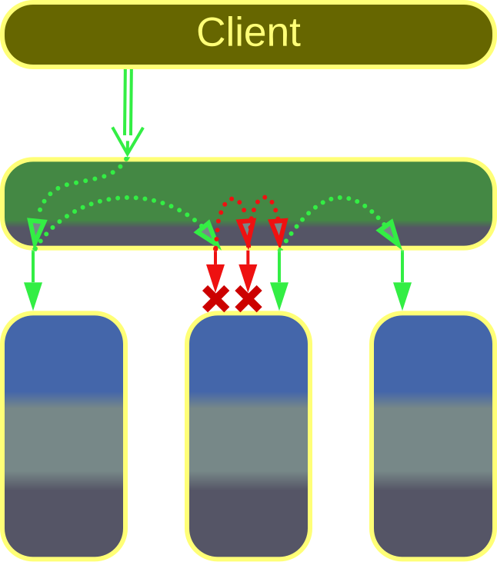
Orchestrator – variants
A Saga is a scenario that updates states of multiple components:
An Atomically Consistent Saga rolls back changes on any error.
An Eventually Consistent Saga retries applying the changes till it succeeds.
Atomically Consistent Saga
Eventually Consistent Saga
Notes:
https://metapatterns.io/basic-metapatterns/layers/

Slide 44
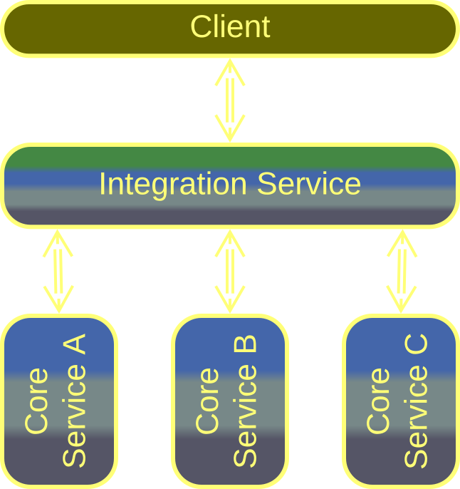
Orchestrator – variants
An Integration Service is a full-featured service which uses other services in its operation.
It tends to implement the application layer (use case logic) in DDD terminology.
Integration Service, Application Service

Slide 45
Combined Component
A multifunctional layer

Slide 46
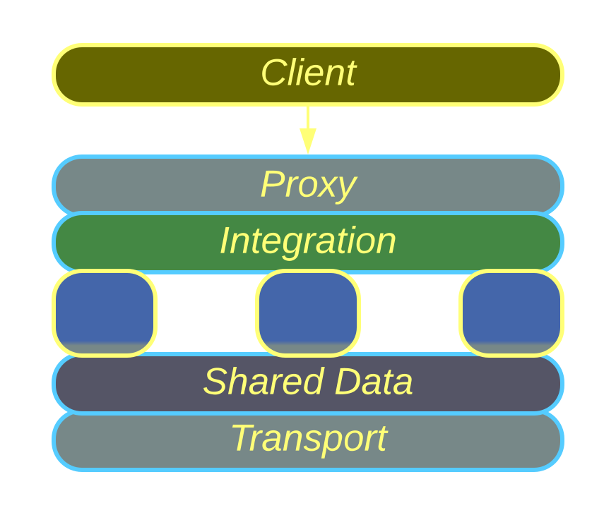
Combined Component – overview
A Combined Component implements the functionality of several different system-wide layers.
Combined Component
Combined Components expedite programming in familiar domains.
It is very hard to replace if you outgrow it.

Slide 47
Combined Component – trade-offs
Covers many of your needs off the shelf
Has better performance and simpler setup than a set of stand-alone layers
Locks you to its vendor
Requires learning a proprietary technology
May be too simple, too complex, or just misaligned for your needs

Slide 48
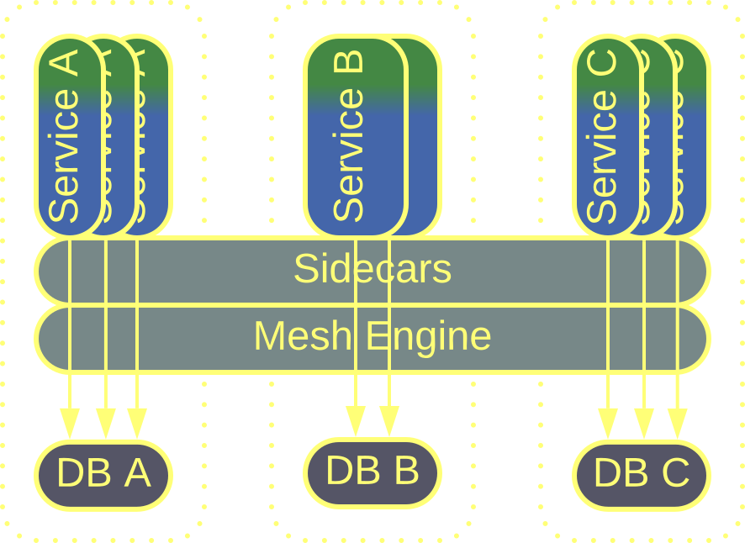
Combined Component – examples
We have already covered several Combined Components:
Service Mesh | Event Mediator | Message Bus | Enterprise Service Bus | API Gateway

Slide 49
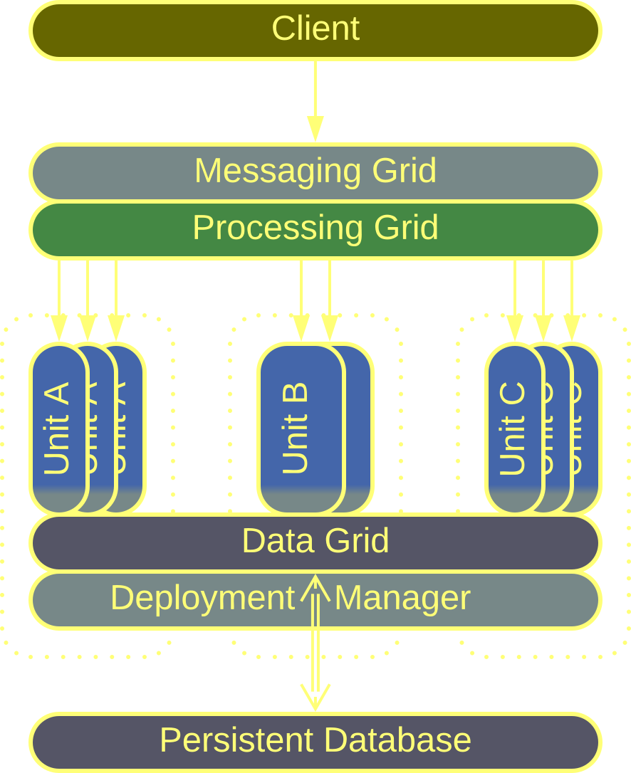
Combined Component – examples
Space-Based Architecture (SBA) provides a complex framework that contains:
Messaging Grid – a Proxy that processes client requests.
A Processing Grid – an Orchestrator for complex workflows.
A Data Grid – a distributed Shared Repository.
A Deployment Manager – a Middleware.
Space-Based Architecture

Slide 50
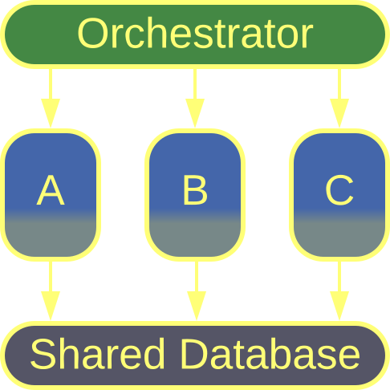
Combined Component – examples
A Cell is an intermediate step in transition from Layers to Services.
The domain logic layer is the easiest to subdivide into services, while other components remain as layers.
Though not being genuine Combined Components, Cells show a similar structure.
Cell

Slide 51
Conclusion

Slide 52
Moving functionality out of services
Each of the extension patterns which we’ve reviewed takes care of some functionality which would otherwise need to be implemented by the main services that contain the business logic.
It is the business logic that makes the core of the business and brings profit to the company. Your teams should concentrate their efforts on developing it. Everything else is expendable and should be acquired when available off the shelf.
Segregating technical or behavioral aspects not only lowers the development complexity, but may also decouple the subdomains, as we see when data-centric systems are built around Shared Repositories or when applications with complex use cases employ Orchestrators.

Slide 53
Links
This was an overview of part 3 of my book Architectural Metapatterns which is available:
– as a website metapatterns.io
– as a PDF or EPUB from leanpub.com/metapatterns
The diagrams and the ODT source file are available under the CC BY license.
More patterns are to follow…

